Slide 1
Name one thing that is extremely dear to you/that you are possessive about…
Week 4 14/09/23

Slide 2
Apostrophe (‘)
BASIC RULES

Slide 3
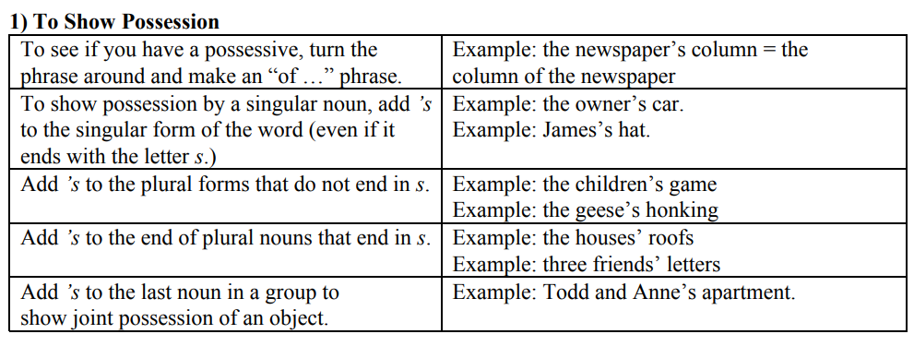

Slide 4
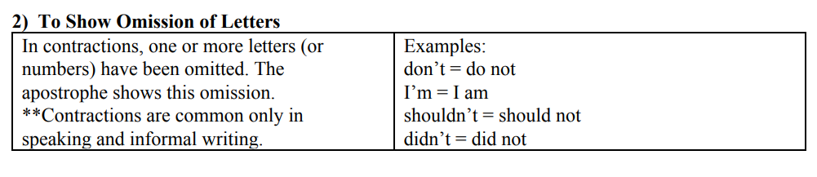

Slide 5
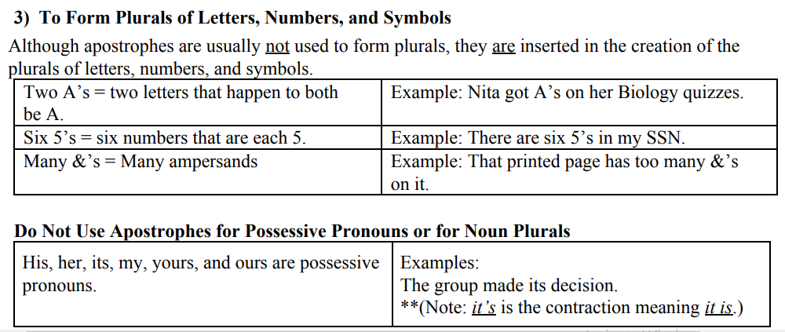

Slide 6
Each sentence has no possessive apostrophes. Put them in. Some italic hints are given.
1. The Head Teachers study is over there. (One head teacher)
2. The geography teachers staffroom is on the left. (Lots of geography teachers)
3. Jack Davies class was the best in the school.
4. The twins teacher despaired of ever telling them apart.
5. Sadie lost two terms work due to a car accident.

Slide 7
Solution
1. The Head Teacher’s study is over there.
2. The geography teachers’ staffroom is on the left.
3. Jack Davies’ class was the best in the school.
4. The twins’ teacher despaired of ever telling them apart.
5. Sadie lost two terms’ work due to a car accident

Slide 8
Include apostrophes where needed in your contractions:
Do not just print entire websites: there is no point paying to print unwanted advertising. Cut and paste required text into a Word document instead so you are printing only what is needed.
If you cannot read articles online in the learning Centre, save them on your memory pen so you can read them later on your laptop or offline, when you are not so pressed for time.
You have got huge margins on the pages of your printed and downloaded e-journal article? You could have used the two pages to a page feature on the printing menu.

Slide 9
4. Who is in charge of your budget? You are! Be mean: learn to read on screen and take proper notes, or just do not print out at all.
5. It is easy to set up a reading group with students from your module.

Slide 10
Solution:
1. Don’t just print entire websites: there’s no point paying to print unwanted advertising. Cut and paste required text into a Word document instead so you’re printing only what ‘s needed.
2. If you can’t read articles online in the learning Centre, save them on your memory pen so you can read them later on your laptop or offline, when you aren’t/you’re not so pressed for time.
3. You’ve got huge margins on the pages of your printed and downloaded e-journal article? You could’ve used the two pages to a page feature on the printing menu.

Slide 11
4. Who’s in charge of your budget? You are! Be mean: learn to read on screen and take proper notes, or just don’t print out at all.
5. It’s easy to set up a reading group with students from your module.

